Slide 1
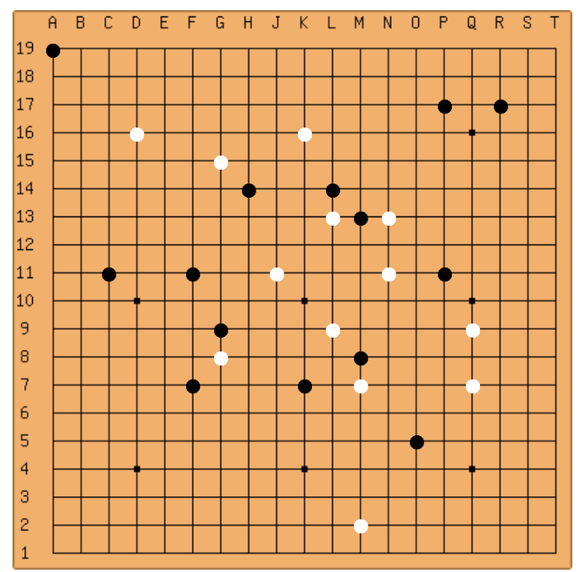
“Five in a Row” Game
By: Nick Baker
Myson Burch

Slide 2

Project Goal
Implement “Five in a Row” game
HTTP Protocol
Wireshark Analysis

Slide 3

Node.js
Javascript Development Environment
Event-driven
Lightweight and efficient
Useful libraries

Slide 4

Node.js Libraries
WebSockets, Socket.IO, etc.
Bi-directional and persistent connection
Allows communication with any number of open connections
TCP-based protocol with some HTTP implementation

Slide 5

GitHub
Online project hosting
Version control
Feature requests
Error tracking

Slide 6
Game Demo

Slide 7
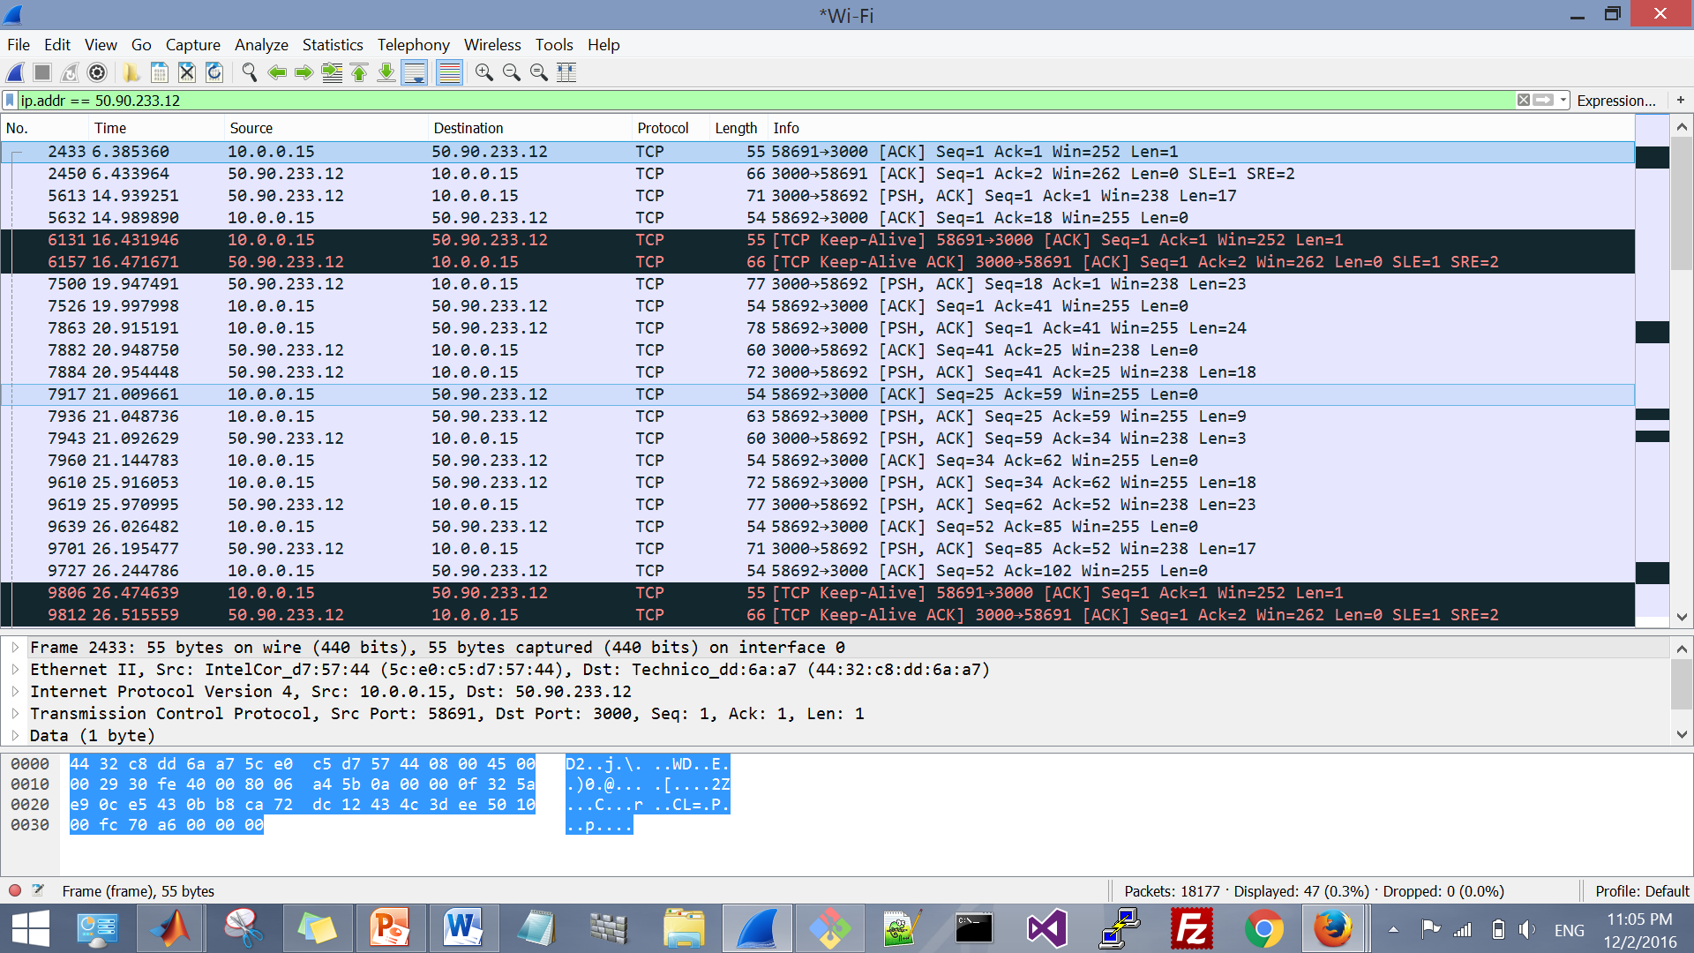
Wireshark Analysis

Slide 8

Conclusion
Room for improvement
Lessons learned

Slide 9
References
"Nodejs-websocket." Npm. N.p., n.d. Web. 27 Nov. 2016.
"Node.js V7.2.0 Documentation." Index | Node.js V7.2.0 Documentation. N.p., n.d. Web. 25 Nov. 2016.
Harris, Andrew. "CSCI 437(00) Game Development I." CSCI 437(00) Game Development I. N.p., n.d. Web. 25 Nov. 2016.

